Slide 1
Listening to Families: Perceptions of the Complex Developmental Behaviour Conditions Assessment and Transition to Community Services
Cairncross N.^{1,2} Howie L.¹ Lanphear N.¹ ³ Gislason M.² Miller K.^{1,2}
¹ Sunny Hill Health Centre for Children, Vancouver, BC
² Faculty of Health Sciences, Simon Fraser University, Burnaby, BC
³ Faculty of Medicine, University of British, Vancouver, BC

Slide 2
Acknowledgments
As a settler, I respectfully acknowledge that I Iive, work, and learn on the unceded Coast Salish Territories of the xʷməθkwəy̓əm (Musqueam), Skwxwú7mesh (Squamish), and Səl̓ílwətaɬ (Tsleil-Waututh) Nations
My deepest gratitude to the families who were able to participate. Your stories matter.

Slide 3
Context
Complex Developmental Behavioural Conditions (CDBC) team
Diagnostic services for children with suspected neurodevelopmental conditions
“Listening to Families” – Quality Improvement Initiative
Navigators Improving Transitions (KNIT)
Improving coordination of care for families affected by neurodevelopmental conditions within the province-wide health service system.

Slide 4
Objectives
Understand the experiences of families of children who had been assessed and diagnosed with Fetal Alcohol Spectrum Disorder (FASD) at SHHC; and,
Ascertain the success with which families were able to implement the recommended resources

Slide 5
“Listening to Families” Quality Improvement Initiative
Population
Legal guardians of children assessed by CDBC team
March 2017-April 2018
FASD without intellectual disability
Data Collection
15 Semi-structured interviews via telephone
Transcribed concurrently
Interview questions refined iteratively
Data Analysis
Qualitative data were coded and analyzed using thematic analysis
Descriptive analysis of the proportion of CDAS recommendations families were able to implement

Slide 6
Implementing Recommendations
Families were connected to 25-100% of recommended services
27% of families were on waitlists for at least one service
On average families connected to 53% of recommended services

Slide 7
Families Steering their own Care

Slide 8
Varying levels of Connection (CDBC and Community Resources)

Slide 9
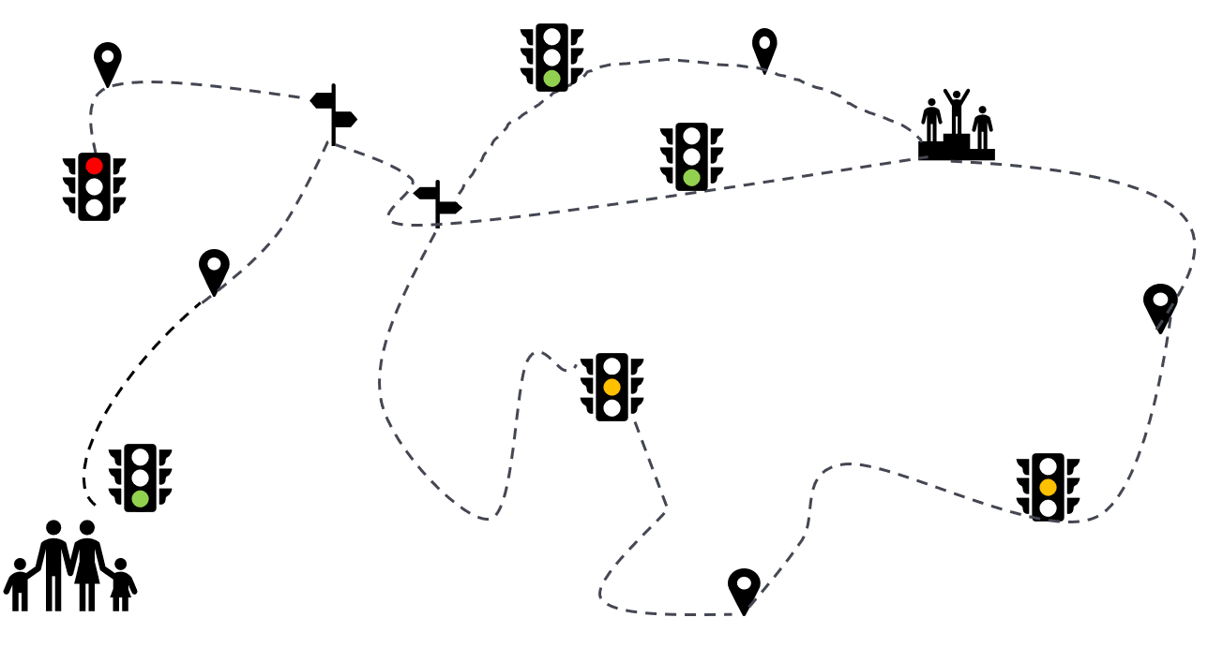
Hitting Road Blocks

Slide 10
Improving the Process for Families
“It was left open for questions… but you’re blown away!”
“I was in shell shock at first… I know what to ask for now!”
“You’re being bombarded. You forget everything once you get home!”

Slide 11
Implications for a Pediatric Navigator
These finding support the potential benefit of identifying ‘navigators’ mandated to strengthening connection and clarity during the transition from assessment to community services.

Slide 12
Thank you

