Slide 1
Smart Home Technologies - Easing Access
Mukhinder Gill
Clinical Technology
(Sunny Hill Health Centre for Children)

Slide 2
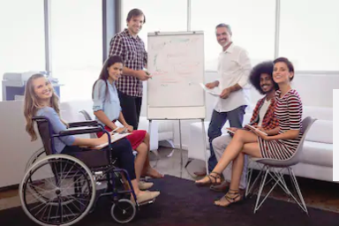
Impact on society
Assistive Technologies can contribute to:
Education
Employment
Social Inclusion
Independent Living

Slide 3
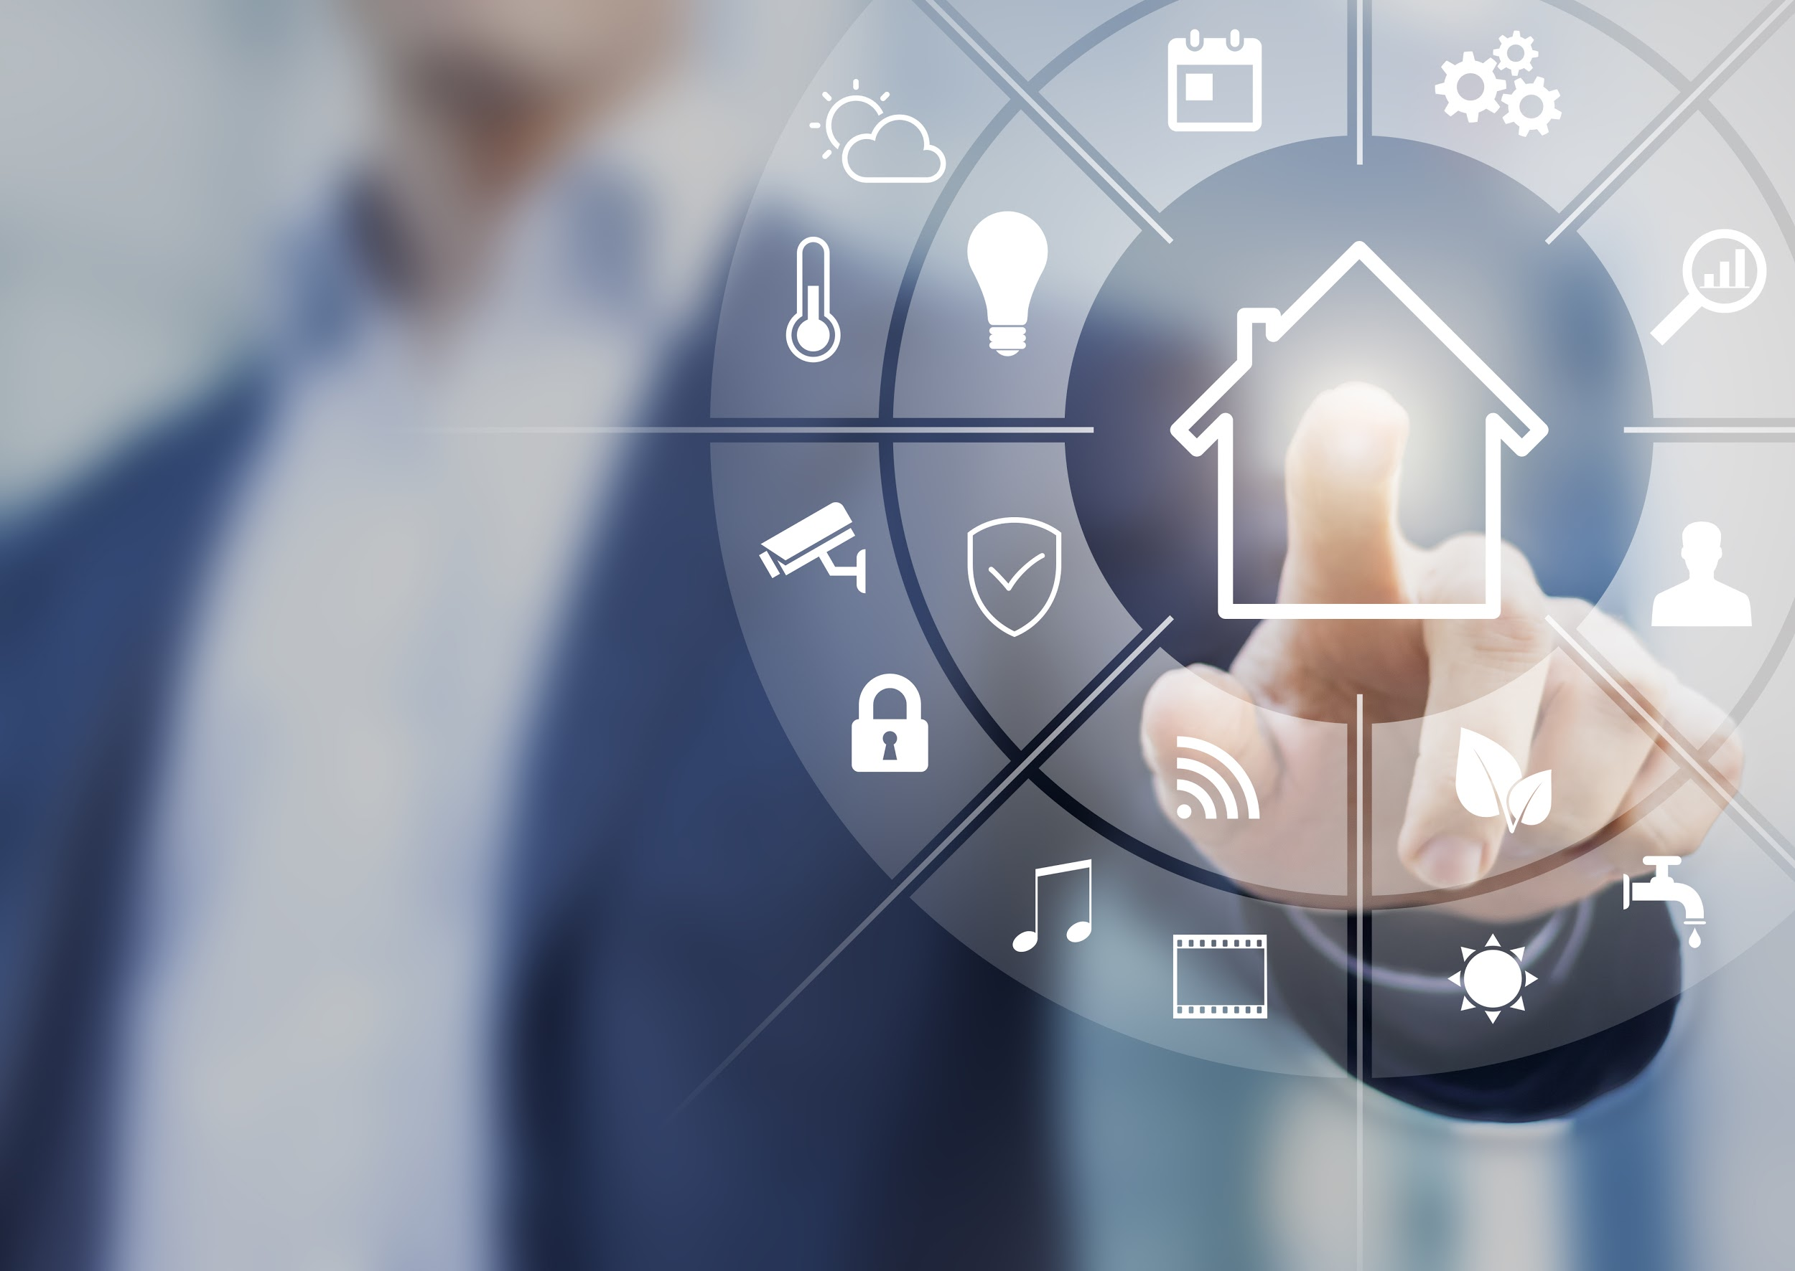
Introduction to Smart Technologies in Health Care
Homes outfitted with Smart devices can be controlled over an internet connection from a desktop, tablet, or smartphone
Appliances
Baby monitors
Blinds
Door locks/ bells
Garage doors
Light Switches/ bulbs/ plugs
Motion sensors/ security cameras
Shower/faucets
Smoke detectors
Speakers (Music)
Sprinklers
Thermostats
TVs
Vacuums
Projected market revenue of IoT and analytics worldwide by 2027 is 520bn USD

Slide 4
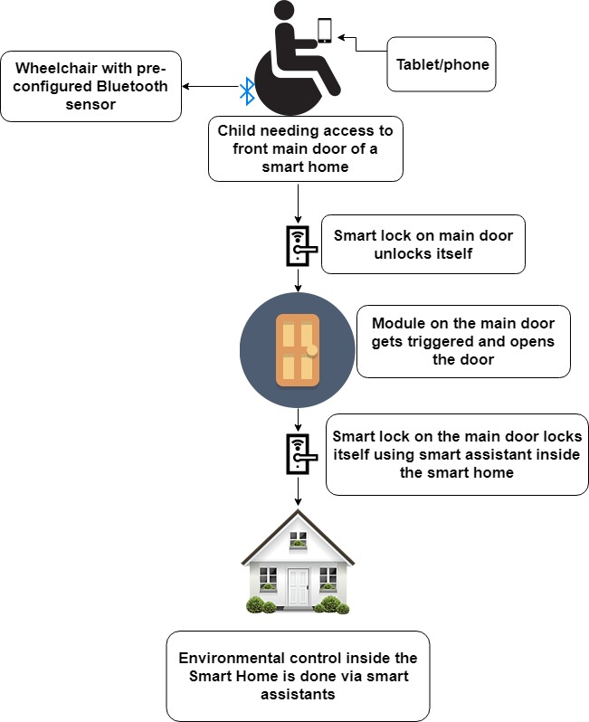
Smart Technologies in Health Care (Use Case)

Slide 5
Set-up & Cost estimates
Wifi connection with excellent signal inside and around your home
Tablet/Smartphone
Spec Switches/Head array for wheelchair
TouchChat HD- AAC w/wordPower IOS Application
Relay switch using IFTTT IOS App - ($35)
Google/Alexa Smart Home assistants- ($50)
4 Pack Smart bulb starter kit/Plug/Thermostat/Front door lock/TV control (8 devices) - ($800)

Slide 6
Smarthomes are:
Expensive
Only meant for Tech-Savvy folks
Difficult to Implement
Vulnerable to Security breaches

Slide 7
Alternatives to Google/Amazon/Apple
Control 4
Savant
Crestron
Z-Wave
Data stays local on the server that’s hosted in your Basement/Garage

Slide 8
Concerns
Reliability in-case of internet/power goes down
Consumers worry about Security & Privacy
Switching between apps may get complex and time consuming on a Tablet/ Smartphone
Updates & maintenance at time may irritate consumers
If smart home company you’ve invested-in got bankrupt

Slide 9
Resources
Statista
BC Association for Individualized Technology and Supports
Get Tecla
AAC Apps with Adaptive Switches
Grid3
TouchChat w/WordPower

