Slide 1
BC Centre for Ability (BCCFA) Bridging the Gap: Feeding Services Paediatric Update Symposium 2019 Nicole Nybo (OT) & Nina Giuliani (OT)

Slide 2
Overview
History of our feeding service
Development, assessment, and redesign
Adaptations
Things to Keep
Next Steps

Slide 3
BEFORE….(pre-2016)

Slide 4
BEFORE….(pre-2016)
Challenges with this model:
Timeline fluctuated
Waitlist bumped
Therapist availability
Imbalance between OT/ SLP Departments
Caseload pick up
Development of skills

Slide 5
Pilot Project (July – Dec 2016)
Interdisciplinary Feeding Team:
Children assigned based on clinical presentation:
OT (0.4)
Movement disorders
Positioning needs
Self feeding concerns
SLP (0.4)
Palate concerns
Potential speech difficulties

Slide 6
Pilot Project (July – Dec 2016)
Roles:
Assessment
Intervention
Parent Coaching
Internal/external referrals
Family liaison between team members
Mentorship for OT/SLP Departments

Slide 7
Pilot Project Assessment
Parent Survey (Oct 2016)
Sent to 22 families serviced within the first 4 months
Received 7 responses (32%)

Slide 8
Pilot Project Assessment
“My child’s feeding skills have improved as a result of this service”
1=Strongly Agree
5=Agree
1=disagree
0=strongly disagree
“Feeding/mealtimes have become a more positive experience as a result of this service”
1=Strongly Agree
6=Agree
0=disagree/ strongly disagree

Slide 9
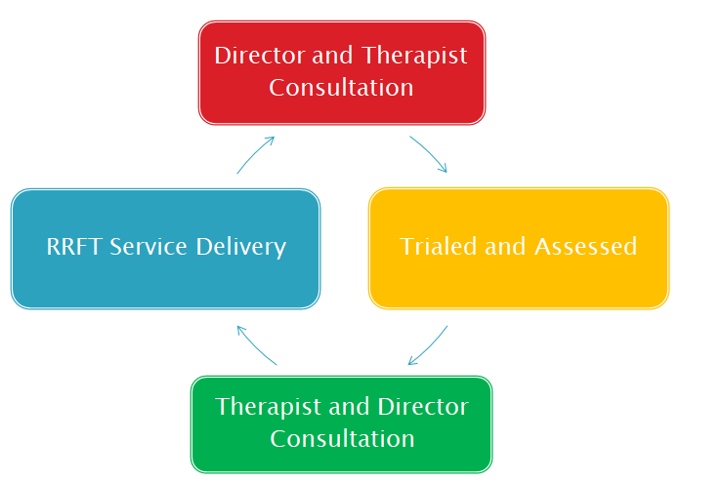
Rapid Response Feeding Team (January 2017)

Slide 10
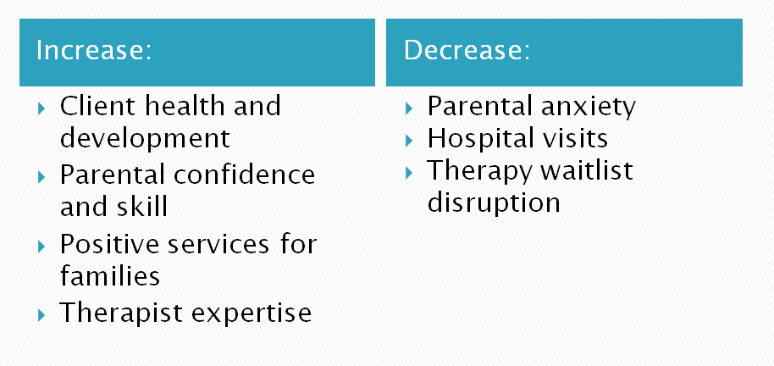
RRFT Expected Outcomes

Slide 11
Departmental Education (2017)
Foundations for Successful Feeding in Infants and Young Children.
Deb Cuthbert (OT) and Janice Duivestein (OT)
Day 1: Infants
Day 2: Older Pediatrics

Slide 12
Reassess (2017 – Feb 2018)
Intake identified:
Inequity of public feeding services across regions
Duplication of services and referrals in Vancouver
Consistent request for Sensory Eating services
Conversations initiated between BCCFA and Vancouver Paediatric Team (VPT) regarding:
Funding
Mandate
Referral confusion

Slide 13
BCCFA Feeding Team (Sept 2018)
BCCFA Early Intervention Therapy (EIT) Feeding Team will take all feeding referrals* for children in the 0-5 year age range for clients in::
*Excluding feeding associated with mental health challenges.

Slide 14
BCCFA Feeding Team (Sept 2018)
Rapid Response Feeding Team
Urgent: Children with concerns around feeding safety and failure to thrive.
Prioritized: Children with oral motor concerns: Not Failure to Thrive (FTT)
Picky Eaters:
Sensory/picky eating concerns with no other developmental concerns.

Slide 15
Feeding Community of Practice (November 2018)
Individual Conversations Group Learning
Open exploration of feeding questions including:
Development and progression of feeding skills
Impact of (low vs high) tone
Encouraging lip closure
Etc…

Slide 16
Therapist’ Feedback (COP)
“1) It’s great to be able to hear and discuss research and strategies together as a group with experienced clinicians to learn from their varied, extensive experience around feeding.
2) Lots of hands-on practical information!“

Slide 17
Therapist’ Feedback (COP)
“I would appreciate more experiential learning, as I often find it difficult to understand what I am seeing when I complete feeding observations. If it’s feasible, perhaps we can invite families or watch videos of current feeding clients to increase learning.”

Slide 18
Try – Assess – Adapt – Try Again…

Slide 19
Adaptations
Community Partners
Educating referral sources
Sharing new service delivery model
Flow Chart

Slide 20
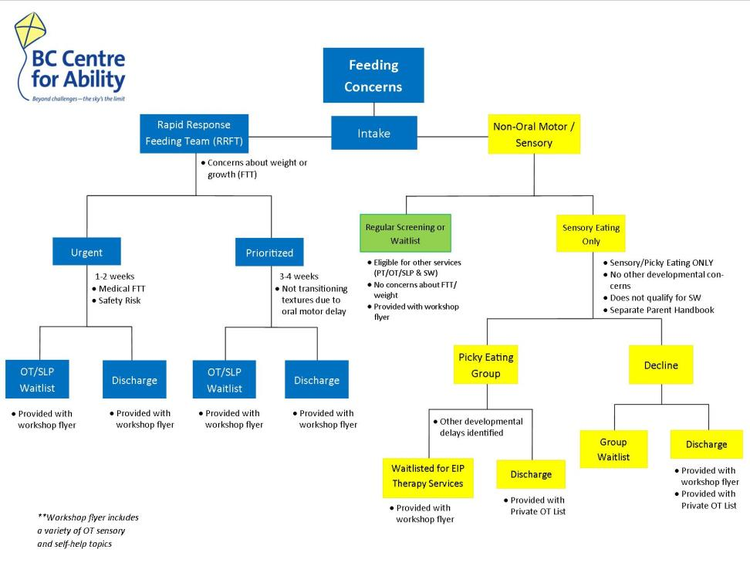
Flow Chart

Slide 21
Adaptations
Waitlist or Discharge?
Minimizing impact on family
Learning what “stable” looks like
Intro letter
Open door policy

Slide 22
Adaptations
Passing on to OT or SLP waitlist?
Difficulties with timely mentorship and discussion between FT and EIT teams
“Clearer/more streamlined process of transferring FT kiddos to other OTs/SLPs.”
“Appreciate the process for referrals, transferring to regular services etc being clarified.”
Therapist assigned

Slide 23
Adaptations
RRFT Caseload =
Unbalanced schedule
Chronic crisis
Video consults
Debriefing sessions
Departmental Training

Slide 24
Adaptations
Increased Referrals =
Backlog in EIT Intake
Urgent or Prioritized?
Prioritized or Regular waitlist?
Requests for SW emotional supports by parents
Feeding team filtering all Intake
Delayed SW assignment

Slide 25
Adaptations
Is RRFT always the right service?
Is a group service adequate for Picky Eaters?
Still working on this…

Slide 26
Try – Assess – Keep!

Slide 27
Things to Keep
Caseload management for EIT therapists:
“It’s great to know those clients are receiving services within an appropriate timeframe without taking time away from my current caseload.”
“In the past, urgent feeding kids would have to be absorbed into my already full caseload – this meant less attention to my other caseload clients and increased stress for me to try to fit them in and support the families as they needed (emotional and clinical support).”

Slide 28
Things to Keep
Community Partnerships
Complex Feeding and Nutrition (BCCH)
Home Trach and Vent Team (BCCH)
SHHC Feeding Team
Royal Columbian Hospital
Dieticians (Health Unit, BCCH, SHHC, 8-1-1)

Slide 29
Things to Keep
Experienced therapists for urgent clients
Increased EIT caseload management
Increased parent confidence
Decreased parent stress

Slide 30
Therapist Feedback
“It’s helpful if they have already seen a client and then I can rest assured my client’s feeding has been assessed by an expert, and recommendations [ have been] provided.”
“Helped to manage caseload; upon pick up it’s so helpful to have the notes from the FT therapist – not starting from scratch but checking in and following up on recommendations.”

Slide 31
Parent’s Feedback
“…It was generally helpful to be presented with options including tools to improve his feeding experience: modified drinking cups and chairs for positioning that we would otherwise have no knowledge of. Often the most difficult thing as a parent is not doing/trying anything at all, so with the help of [Therapist] at least it felt like we were providing some attention to a very stressful situation.”

Slide 32
Parent’s Feedback
”[The therapist] was very knowledgeable and experienced. She was able to give us the reassurance that our daughter didn't have a sensory issue when it came to feeding, it was more the need to take a step back so she can improve in her ability to chew. So that placed me more at ease and less stressed at mealtimes. Home visit was really helpful too, so she can assess the environment and look closely at the food and how my daughter handles it. Really appreciated that.”

Slide 33
To Keep
Home based services for RRFT
“Having [the therapist] come to the house was paramount. There is no way I would have had any success taking our infant out to the BCCFA location. Feeding was so difficult already that if we had been in a foreign space, our son would have been even less cooperative during our visits. Secondly, as an completely exhausted mother I was in no condition or spirit to drive to more appointments since our sons list of medical appointments was often 2-3 per week at times and his sibling was also needing my care.”

Slide 34
To Keep
Picky Eaters Group – Parent Feedback:
“The group provided him with the ability to touch foods – and he no longer fears them. We’re very thankful for that. It also gave us insights on how to improve his eating and we have the knowledge to move forward with his eating step by step.”

Slide 35
To Keep
Picky Eaters Group – Therapist Feedback:
“ I had 6 children registered for the group, with ages ranging from almost 2 years to 4 years old. We had a lot of fun with our food play and I was impressed that every week, each parent/grandparent had a success story from home to share! These families were creative and willing to try new ideas – and as a result, each child made progress in their food interactions.”

Slide 36
To Keep
Regional equality for feeding services
Families in all regions can now access services for oral motor and picky eating concerns.
Earlier services, earlier solutions
Critical feeding windows
Addressing environments and attitudes

Slide 37
To Keep
Feeding mentorship across EIT:
OT/SLP Therapists
Group Therapy for Picky Eaters
Interdisciplinary collaboration:
Community of Practice
Physiotherapy
Social Work

Slide 38
Therapist Feedback
Feeding Team:
“I like that the family starts off with highly experienced feeding therapist and gets off on the right track by the time they come to me. I can also consult the feeding therapist once I pick up.”

Slide 39
Therapist Feedback
Community of Practice:
“[A positive is] having OTs & SLPs together in the group, as sometimes we come from slightly different angles so it has been helpful to hear different strategies, ideas, things to consider and even share different parent handouts and resources.”

Slide 40
Summary of Success
“Upon regular pick up families seem to feel more confident in managing feeding concerns and less stressed about their child’s eating challenges.”

Slide 41
Next Steps
OT/SLP Departmental (Re-)Education (April 2019)
Continue to increase skill and confidence across OT/SLP departments through COP and individual mentoring
Increased collaboration with mental health resources
Formal funding to support RRFT and Sensory Eating Group long term
Research?

Slide 42
Ideas & Sharing
What do you think we should add or consider in our service delivery?
What other resources should we tap into?
What are you doing in your regions?
Challenges?
Successes?
Dreams?

Slide 43
Questions?
Nicole Nybo: Nicole.Nybo@bc-cfa.org
Nina Giuliani: Nina.Giuliani@bc-cfa.org
Thank you! ☺

